Slide 1
Just do it
James 1:21-27
John 13:17

Slide 2
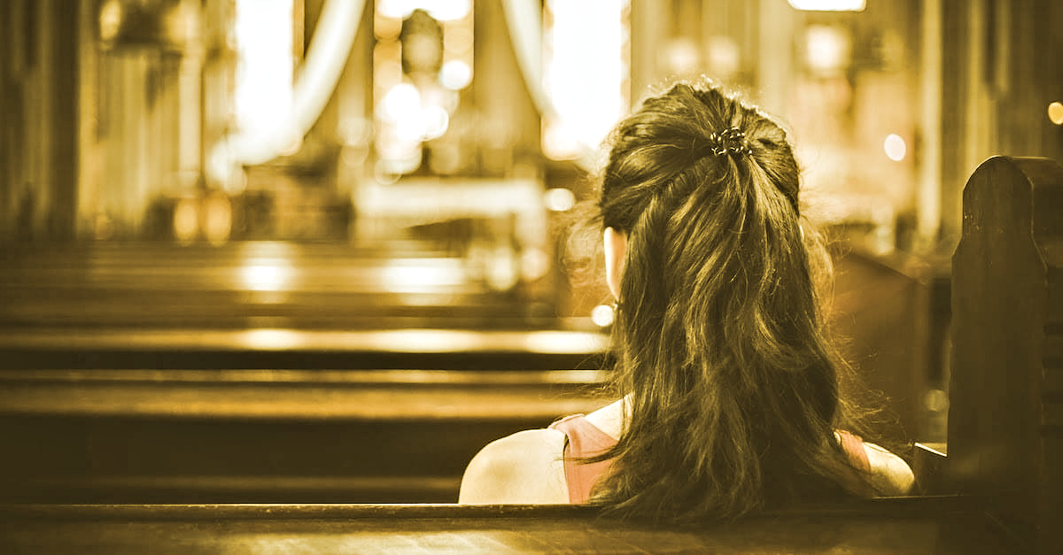
I. Gotta KNOW it [hear the word]
So then faith cometh by hearing, and hearing by the word of God.
Romans 10:17

Slide 3
II. gotta be it (Be free) [you can’t do it until you be it]

Slide 4
III. Gotta DO IT

Slide 5
Just do it
James 1:21-27
John 13:17

Slide 6
I. Bible - Power of God - Power of the Gospel - Power of Grace II. Body - Members ready - motive right - mercy shown III. Building - Remove the excess - Remodel when needed - reinforce a welcome

Slide 7
20 Things to Do
Pastor Mark Bishop

Slide 8
REMEMBER: Every church member is a host, not a guest. Making visitors feel welcome is primarily the responsibility of the members, not the nebulous church.

Slide 9
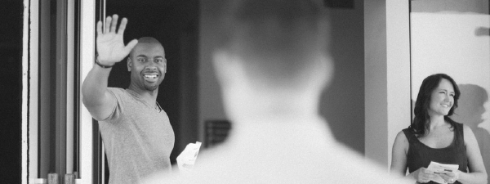
The most important person for a visitor to talk to in order to feel at home in a new church YOU. It is not the pastor, or the greeter, but a regular attender. Eshleman says “One of the most impressive gestures we can extend to first time visitors is for people with no official position to take initiative and welcome them.

Slide 10
Treat first time visitors as guests of God, not strangers
Smile at everyone and offer your hand
Look people in the eye
Ask questions to learn about your guest
Listening is a very effective way to show love
Greet children at their level
Take initiative, don’t wait on someone else
Learn people’s names and remember them
Use appropriate touch
Such as: handshake, pat on back
Let children be children
Invite visitors to join YOU at something (fellowship meal, sitting with you at service, etc)
Never let new people sit alone

Slide 11
Help visitors find seating that suits their needs
Help by giving new people a tour to help them feel more comfortable
Invite them to fill out a connect card or visitor registration
Let them know you’re glad they are here
Pray for them throughout your week
Be yourself!!!

