Slide 1
Kenny Rager D.Ed.Min
Evangelism Associate

Slide 2
identifying the lost

Slide 3
Have you ever said (or heard another Christian say), “I just don’t know any lost people.” How truthful is a statement like this? Why do Christians make this kind of statement?
Do some churches isolate themselves from the lost communities that surround their church buildings? Do individual Christians isolate themselves from the lost? Why or why not?

Slide 4
Personal Evangelists must identify the lost within their networks.

Slide 5
the work of the evangelist
"But as for you, exercise self-control in everything, endure hardship, do the work of an evangelist, fulfill your ministry," (2 Timothy 4:5).

Slide 6
the work of the evangelist
There is an estimated 160 million unchurched people in the United States.
Some may be backslidden or wayward Christians.
It is likely the majority are lost.
Now consider a global population of more than 6 billion people.

Slide 7
the work of the evangelist
Churches should desire to grow numerically, but is numerical attendance in a church service the answer?
The Brooklyn Tabernacle is one of the largest churches in New York City and has reached many New Yorkers with the gospel. Jim Cymbala says, “The Bible does not say we should aim at numbers but rather urges us to faithfully proclaim God’s message in the boldness of the Holy Spirit. This will build God’s church God’s way.”
A proclamation of the gospel (not attendance) is the answer.

Slide 8
the work of the evangelist
Personal evangelists must be intentional.
Must go outside their normal activities.
Must establish new relationships.
Must be confrontational (meaning we must come to the point that we confront people about their need for Christ).

Slide 9
the work of the evangelist
Activities I am involved in.

Slide 10
group discussion
There is an estimated 160 million unchurched people in the USA and the majority are lost. Considering the global population is 6 billion people, what kind of emotions or thoughts come to mind?
Why do we celebrate attendance more than a faithful proclamation of the gospel? What affects would a faithful proclamation of the gospel have on attendance?
Which of the three components of being intentional do you find the most challenging? Why?
What activities are you involved in that include lost people? Where could you be involved and find more lost people?

Slide 11
engaging the
lost

Slide 12
engaging the lost
John 4:35
“Open your eyes and look at the fields, because they are ready for harvest.”
2 Corinthians 5:17-21
“ Therefore, if anyone is in Christ, he is a new creation; the old has passed away, and see, the new has come! Everything is from God, who has reconciled us to himself through Christ and has given us the ministry of reconciliation. That is, in Christ, God was reconciling the world to himself, not counting their trespasses against them, and he has committed the message of reconciliation to us. Therefore, we are ambassadors for Christ, since God is making his appeal through us. We plead on Christ’s behalf: 'Be reconciled to God.’ He made the one who did not know sin to be sin for us, so that in him we might become the righteousness of God."

Slide 13
engaging the lost
A common temptation for Christians may come in the form of disassociating oneself from those who do not know Christ. Many Christians tend to ignore the lost around them. Bill Henard offers an explanation for this for phenomena:
“Truthfully, most Christians probably do not like being around non-Christians. Once Christ has transformed an individual, that person will often become very aware of the behavior of others. People outside of Christ become offensive in the language they use, in the attitudes they demonstrate, and in the behaviors they accentuate. As a result, many Christians isolate themselves from non-Christians.” (The Great Commission Leader, 273-74)
Isolation is not an option. Sadly, the Great Commission has become the “Great Omission.”

Slide 14
engaging the lost
Be encouraged: 8 out of 10 unchurched people indicate that they would come to church if invited.
Be encouraged: 75-90 percent of those who come to faith did so through a friend or relative.

Slide 15
engaging the lost
Understand your οἶκος (“oikos”, Greek for household).
Your oikos are those who are in close connection.
Evangelistic opportunities in my world.
Tom Mercer writes, “God has given each of us, on average, anywhere from eight to 15 people who He has supernaturally and strategically placed in our relational worlds. … This is the world He wants to use each of us to change, our individual world.”

Slide 16
engaging the lost
Oscar Thompson believed that the most important word in the English language is the word “relationship.” He reached this conclusion by observing the outward wave that the gospel traveled in the book of Acts (from Jerusalem to Judea, then Samaria, and then the uttermost parts of the earth). In Thompson’s view, the gospel continues to move outward in the Christian’s relationships, beginning with those in close relationship with the Christian and then extending out to acquaintances and strangers.

Slide 17
engaging the lost
Thompson’s concentric circles

Slide 18
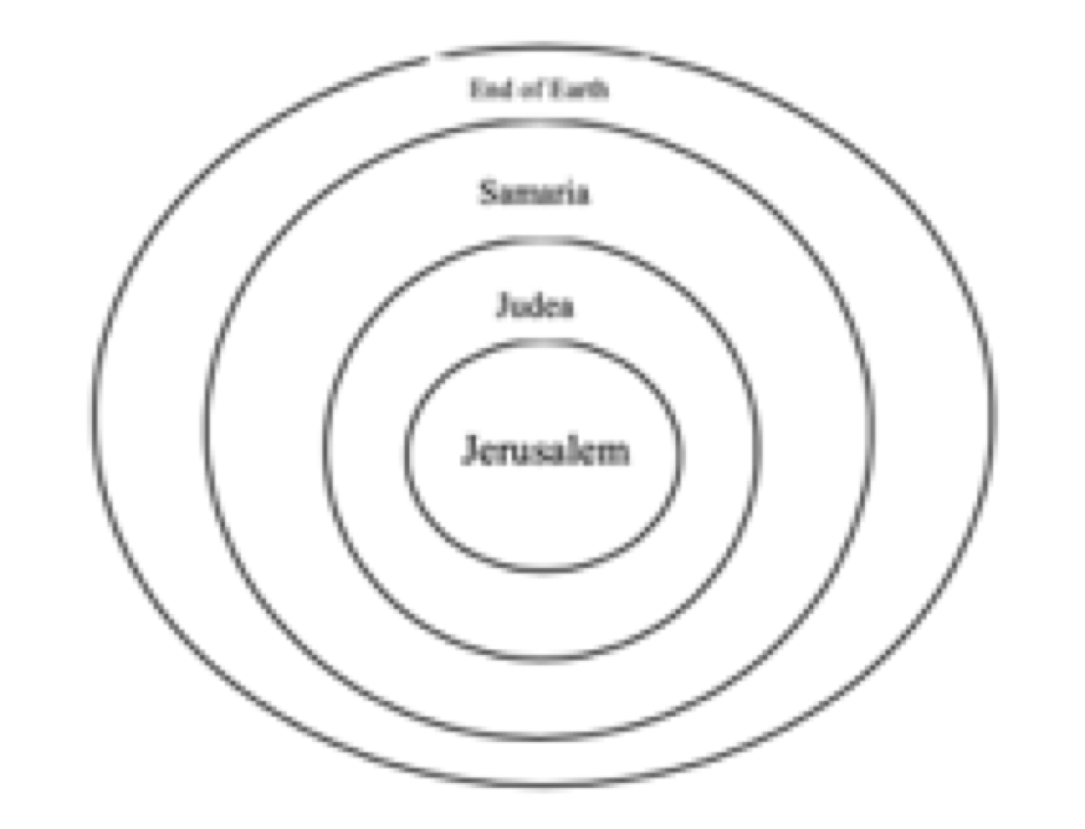
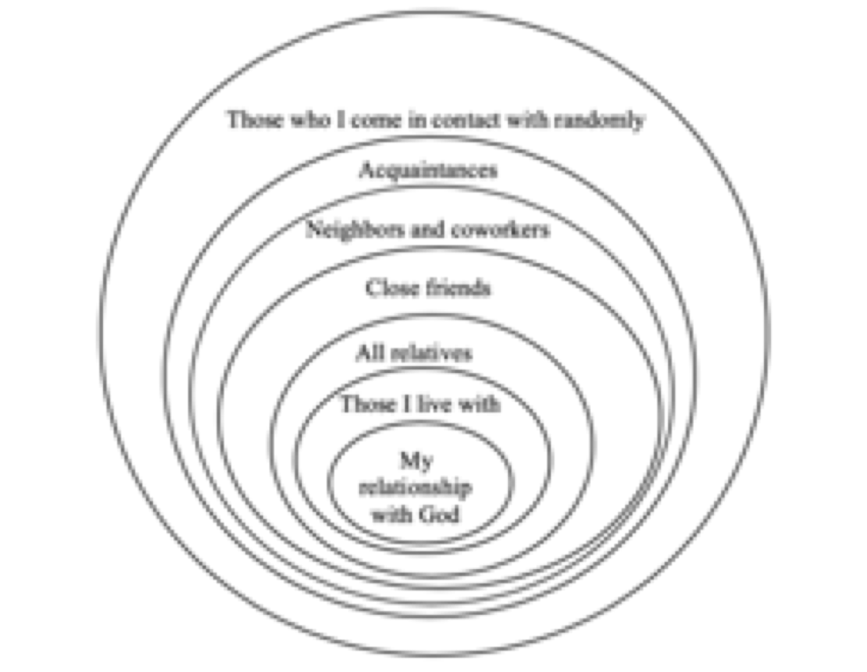
engaging the lost

Slide 19
engaging the lost
“I actually have people tell me that they don’t really know any non-Christians, but that’s because no one has ever trained them to think oikocentrically. We are all more connected to non-believers than we realize,” says Tom Mercer.
Identify the lost within your networks. List their names under their relationship to you.
Disobeying the Great Commission is not an option for a believer, especially if the believer has discovered connections with specific lost people.

Slide 20
personal reflection
Share with the group the total number of lost within your oikos. Also identify the column that has the most lost in it.
If your stronger relationships are already with Christians, how can you strengthen the weaker relationships?
What is your greatest insight from this lesson?

Slide 21
group activity
All group members should identify where they live on a city map. Physically mark the map to represent your home as a lighthouse for that area. Pray for the city.

