Slide 1


The Lord
had done
great things for us;
we were
joyful.
PSALM 126:3

Slide 2

Jesus said,
"But those who
drink the water
I give them
will never thirst."
JOHN 4:14

Slide 3

“Believe in
the Lord Jesus, and you will
be saved—you and your household.”
ACTS 16:31

Slide 4

For the wages
of sin is death, but the gift
of God is eternal life in Christ Jesus our Lord.
ROMANS 6:23

Slide 5
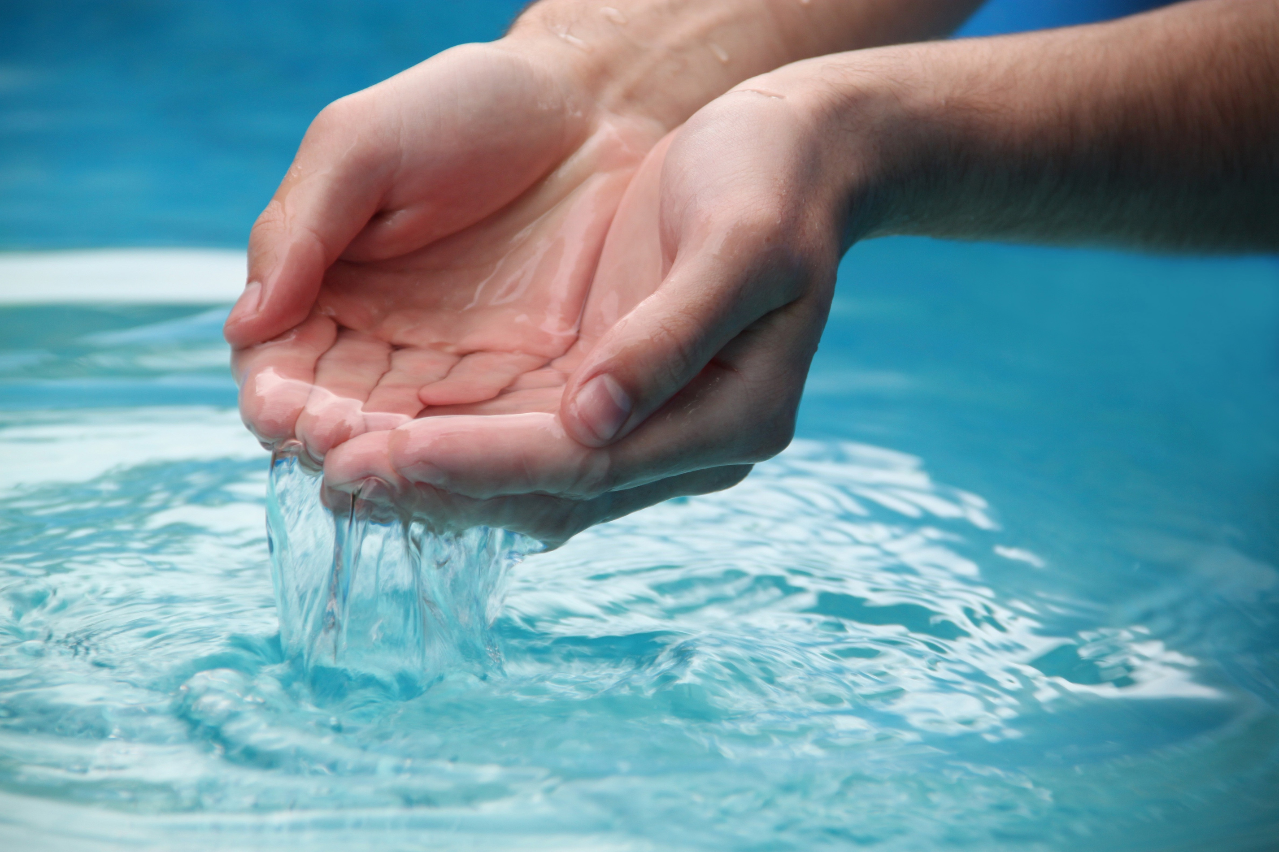
“Look,
there’s water. What would keep me from being baptized?”
ACTS 8:36

Slide 6
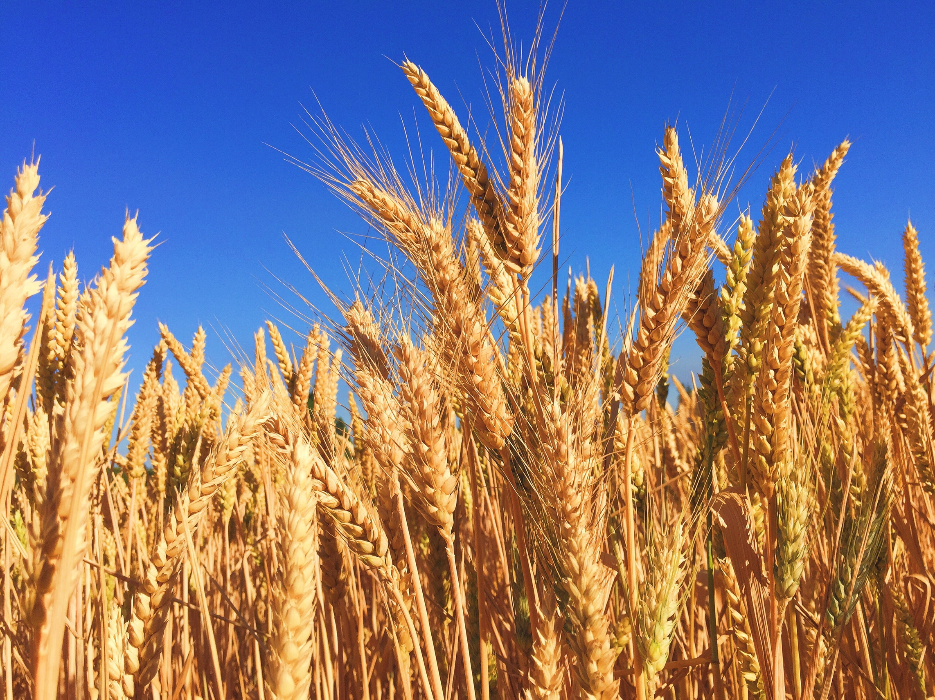
Jesus said
to his disciples, “The harvest
is abundant,
but the workers are few.”
ACTS 8:36

